Slide 1
Gulf of Mexico Pilot Prediction Project
(GOMEX-PPP)
RPSEA-TAC, SAN RAMON, CA
19 OCT 10
Chris Mooers, PI
Portland State University
Portland, Oregon
cmooers @cecs.pdx.edu
(O) 503-953-2556
Cort Cooper, Chevron, Co-PI
Dave Driver, BP America, Co-PI
Sponsor: RPSEA; Cost Share: CASE, Chevron, & BP America
Duration: 30 mos; Total Funding: $1.56M; Start: 10 MAR 10

Slide 2
GULF OF MEXICO – PILOT PREDICTION PROJECT (FRAMEWORK)
SOCIETAL MOTIVATIONS
  OFFSHORE INDUSTRIES NEED CURRENT FORECASTS FOR SAFETY & EFFICIENCY
  ENVIRONMENTAL & EMERGENCY MANAGERS (IOOS: GCOOS & SECOORA) NEED CURRENT FORECASTS TO UNDERPIN ECOLOGICAL FORECASTS
  NAVY & NOAA NEED CURRENT FORECASTS TO SUPPORT MANDATED MISSIONS
TECHNICAL DELIVERABLES
  EVALUATION OF MULTIPLE DATA-ASSIMILATIVE CIRCULATION MODELS
  DEMONSTRATION OF PROTOTYPE MESOSCALE OCEAN PREDICTION SYSTEMS
  RECOMMENDATION OF A CONCEPT OF OPERATIONS (CONOPS)
APPROACH
  PHASES
  EXPERIMENTS
  PARTICIPANTS

Slide 3
PHASES
FIRST (18 MOS.), RUN & EVALUATE FORECAST EXPERIMENTS; SELECT “BEST” PATH TO OPERATIONAL SYSTEM: SINGLE MODEL VICE ENSEMBLE OF MODELS?
SECOND (12 MOS.), RUN PROTOYPE OPERATIONAL SYSTEM IN REAL-TIME; OBTAIN USER/STAKEHOLDER BUY-IN
THROUGHOUT, DEVELOP CONCEPT OF OPERATIONS (CONOPS) TO FOSTER TRANSITION FROM R&D TO OPERATIONS

Slide 4
STATUS OF TASKS
TASK
1. PMP & “KICK-OFF” MTG
2. ASSESS TECH STATUS
3. PLAN TECH TRSFR
4. ROUTINE RPTS
5. IDENTIFY USER NEEDS
6. SELECT MODEL (S)
7. DEMO OPNL FCSTS
8. FINALIZE MODELING SYS
& TECH TRSFR
COST
$30K
$10K
$10K
$100K
$50K
$746K
$300K
$314
TOTAL
$1,560K
SKED
AUG 10
AUG 10
AUG 10
OCT 10
NOV 10
SEP 11
END PHASE II
END PHASE II
DELIVERABLES
RPT
RPT
RPT
RPTS
RPT
RPT & MSS
DEMO, RPT, & MSS
RPT

Slide 5
EXPERIMENTAL PLAN;
I.E., ESTABLISH MODEL TESTBED
FOCAL PHENOMENA:
  LOOP CURRENT,EDDY-SHEDDING,FRONTAL EDDIES
  TROPICAL CYCLONE RESPONSE
  PARTICLE TRAJECTORIES (SPILL DISPERSION)
FOCAL PERIOD: 2009 & 2010
(USE BOEM (x-MMS) & OTHER DATA ARRAYS)
SKILL ASSESSMENT METRICS
  BASIC DYNAMICS (e.g., EDDY-SHEDDING)
  RIG IMPACT RISK (LCE CPA)
  IMPACT OF DOWNSCALING ON SHELF MODELS

Slide 6
R&D PARTICIPANTS
(SUB-CONTRACTORS & CONTRACTOR)
DONG-SHAN KO, NAVAL RES. LAB (NCOM)
LEO OEY, PRINCETON U. (POM)
RUOYING HE, NCSU (ROMS)
YI CHAO, JPL & UCLA (ROMS & 3DVAR)
MATT HOWARD, STEVE DiMARCO, & ANN JOCHENS, TAMU (DATA MGMT & ANALYSIS)
CHRIS MOOERS & ED ZARON, PSU (COORDINATON & SKILL ASSESSMENT)

Slide 7
FEDERAL OPERATIONAL PARTNERS
FRANK BUB, NAVAL OCEAN. OFFICE (NCOM)
{PLUS JOHN HARDING, NORTHERN GULF INSTITUTE/MSU & JERRY WIGGERT,USM}
HENDRIK TOLMAN & AVICHAL MEHRA, NOAA/NWS/NCEP (HYCOM)
RICH PATCHEN, NOAA/NOS/CSDL (POM)

Slide 8
PROJECT INTEGRATING ACTIVITIES
CONSTRUCTION OF GOMEX-PPP WEBSITE
PARTICIPATION IN MULTI-MODEL GOMEX OCEAN PREDICTION EXPERIMENTS
COLLECTIVE SKILL ASSESSMENT OF MODEL PERFORMANCE IN THE EXPERIMENTS
CONTRIBUTIONS TO MULTI-AUTHORED PEER-REVIEWED MSS
PARTICIPATION IN OUTREACH, ETC. WORKSHOPS

Slide 9
MATT HOWARD, STEVE DIMARCO,
&
ANN JOCHENS, TAMU
DATA MANAGEMENT, MODEL SKILL
ASSESSMENT, & GCOOS LIAISON

Slide 10
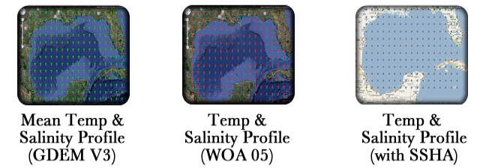
TAMU Provides Modeling Resources
Naval Research Laboratory’s Generalized Digital Environment Model (GDEM V3.0)
National Ocean Data Center’s World Ocean Atlas Data Base (2005) Climatologies
Dynalysis of Princeton’s Synthesized Temperature and Salinity Profiles from SSHA
Notes:
We are building a Modeling Resource Center.
We have extracted Gulf of Mexico subsets of the Navy and NOAA climatologies of temperature and salinity (and their standard deviations) for use by the modeling community.
The information is available in flat ASCII files. We will also make it available in netCDF suitable for remote automated access with subsetting capabilities.
We routinely acquire the NCEP NAM wind forecast fields.

Slide 11
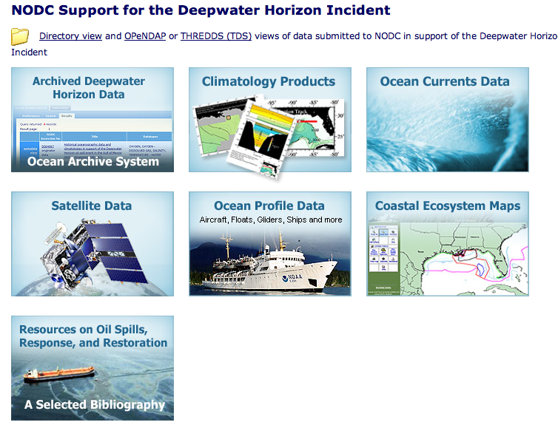
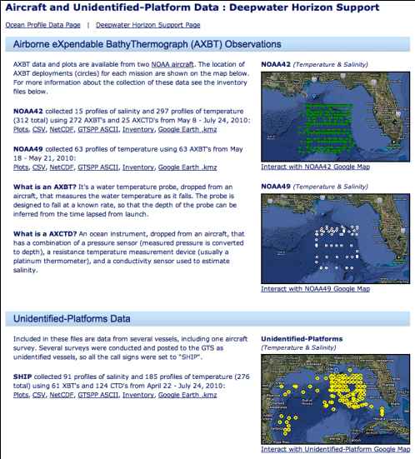
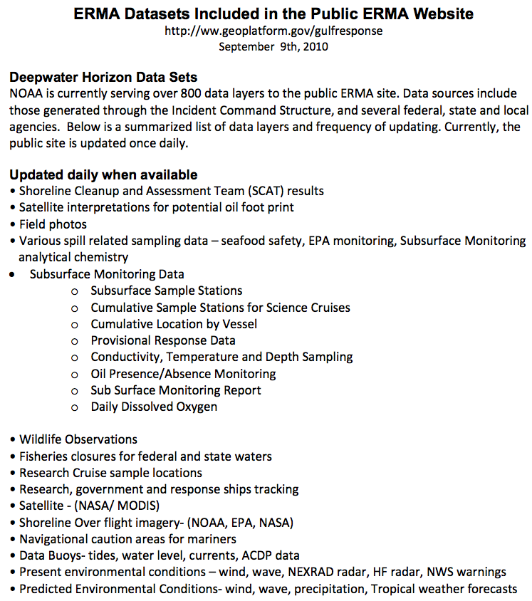
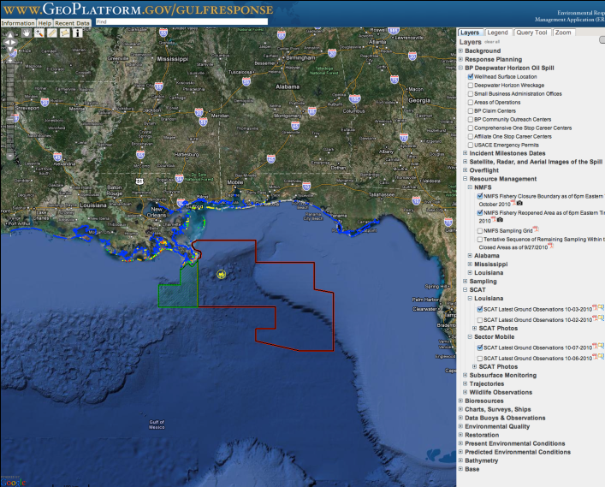
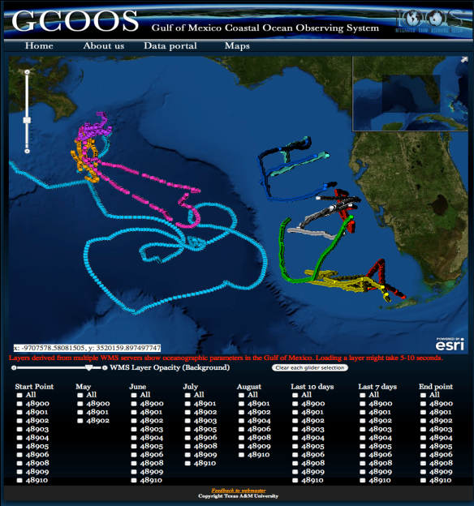
Deepwater Horizon Data
Notes:
TAMU has begun to harvest data generated by the tremendous ad hoc sampling associated with the Deepwater Horizon Oil Spill response. These data are harvested from a variety of locations. (figures show some places)
TAMU also acquires data from observing assets that operated before, during, and after the spill such as NDBC buoys, ADCPs on rigs, and other ship-based field studies.
Peter Hamilton of SAIC – says some data from the Loop Current Study (GREEN Map) recovered in July may be available in November 2010 (personal communication).
We have begun to read/plot these data sets (Lower right-hand panel – Glider data plotted in TAMU GIS system).

Slide 12
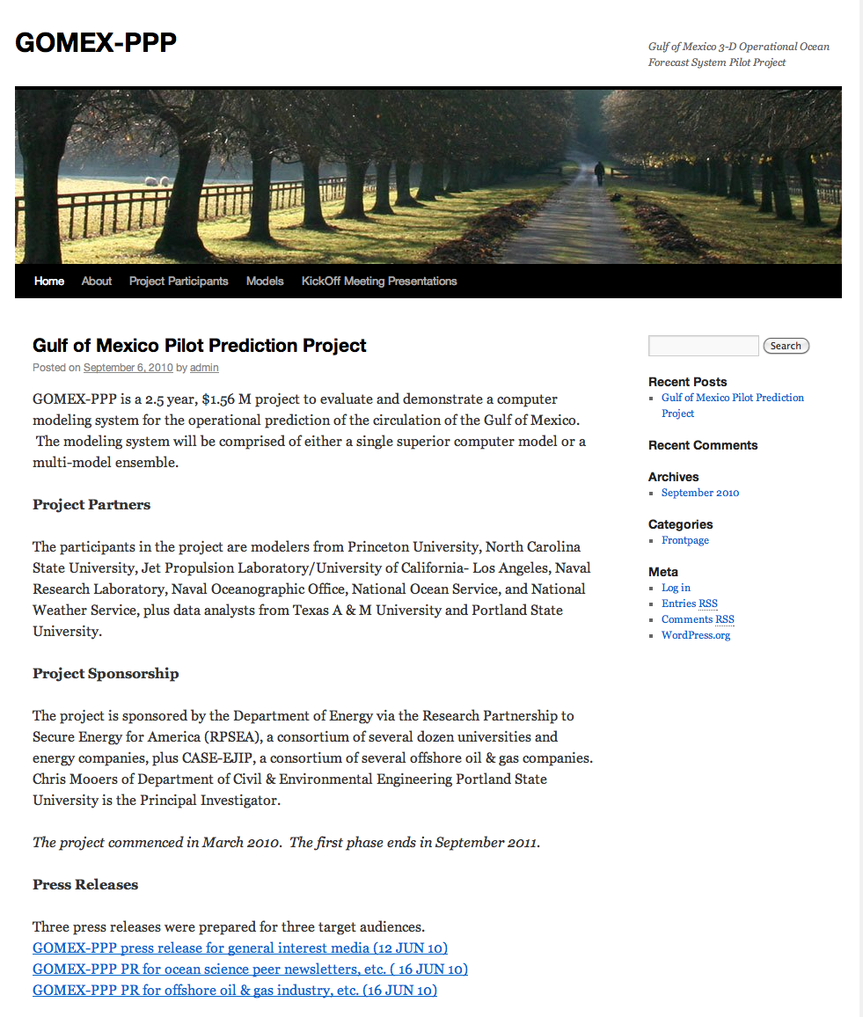
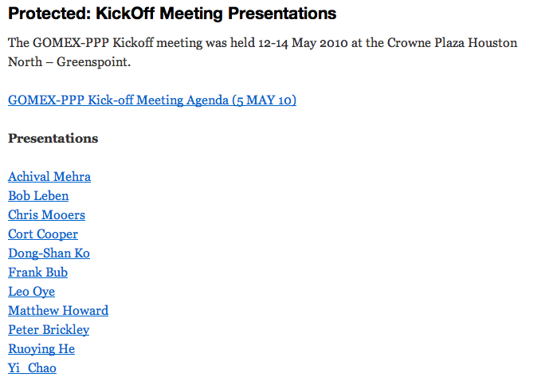
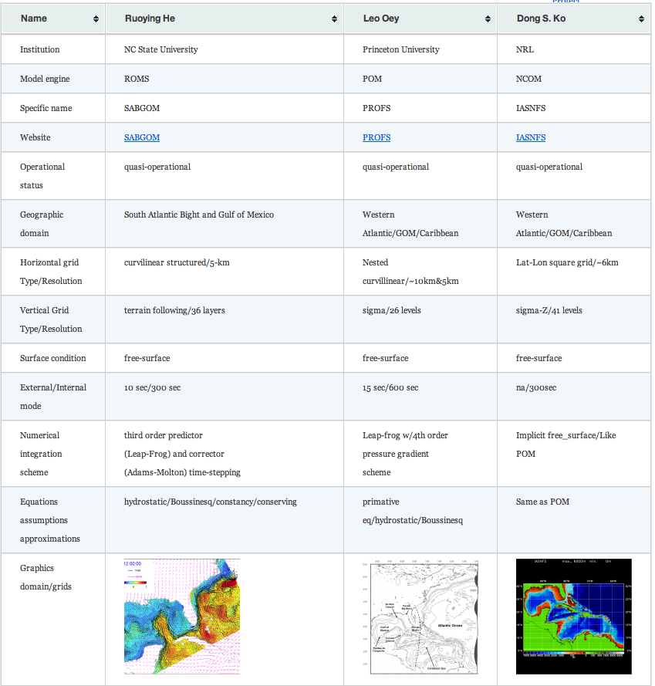
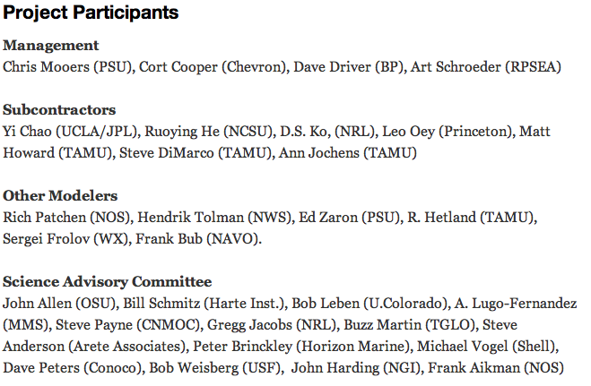
GOMEX-PPP.ORG
Notes:
GOMEX-PPP.ORG website established using WordPress content management system. Content currently includes press releases, project partners, model descriptions, protected pages for kick-off meeting presentations.
PASSWORD iS GOMEX-PPP (all capital letters).

Slide 13
DONG-SHAN KO, NRL
IAS/NFS NCOM

Slide 14
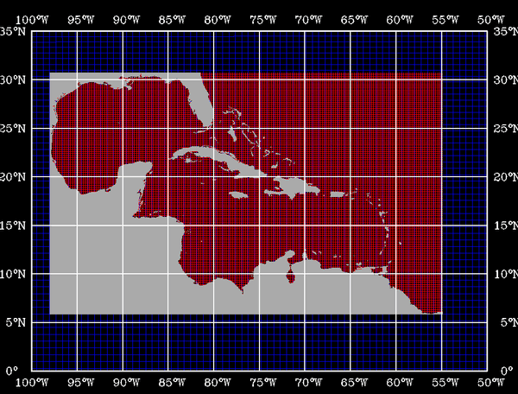
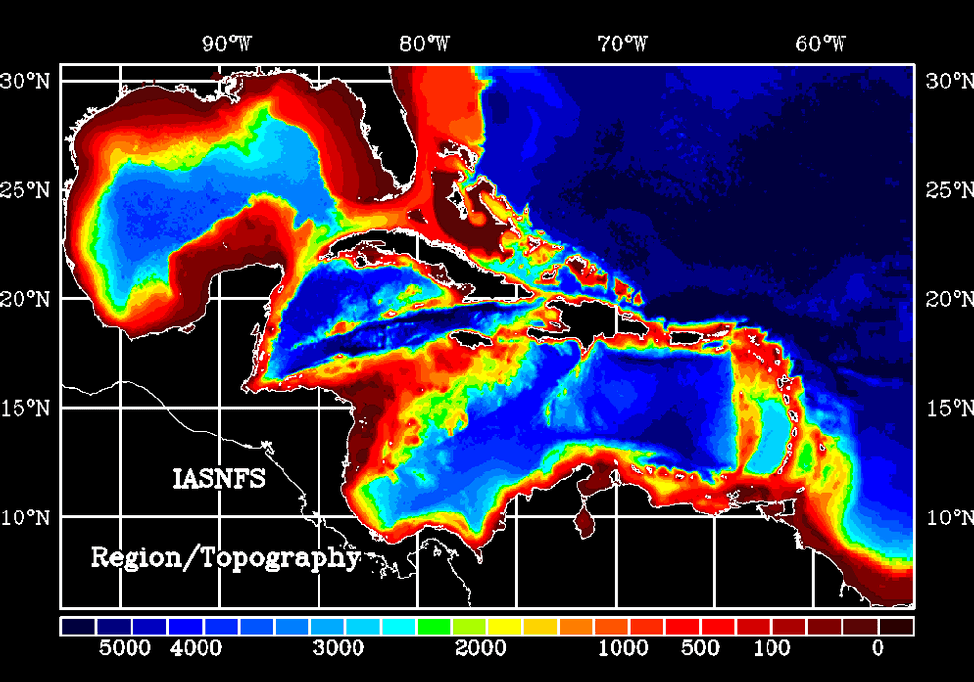
IASNFS Model Grid and Topography
Model Grid
Model Topography
from NRL DBDB2
Longitude : 98 W – 55 W; Latitude : 5 N – 31 N
Horizontal Resolution : 1/24 Degree (~ 6 km)
Vertical Resolution : 40 Layers (19 Layers on the shelf)
Forced with NOGAPS Wind, Air Pressure and Heat Fluxes (Solar Radiation)
Coupled to NRL Global NCOM
Assimilation of Satellite Altimetry and MODIS SST/SSS
140 River Discharges
Ko, D.S., R.H. Preller, and P.J. Martin, An Experimental Real-Time Intra Americas Sea Ocean Nowcast/Forecast System for Coastal Prediction, Proceedings, AMS 5th Conference on Coastal Atmospheric & Oceanic Prediction & Processes, 97-100, 2003.

Slide 15
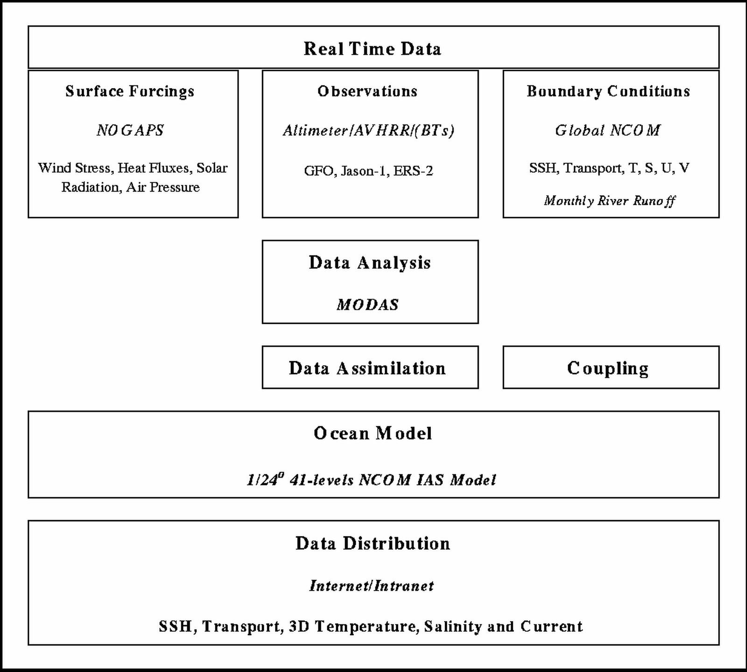
NRL Nowcast/Forecast System (IASNFS)

Slide 16
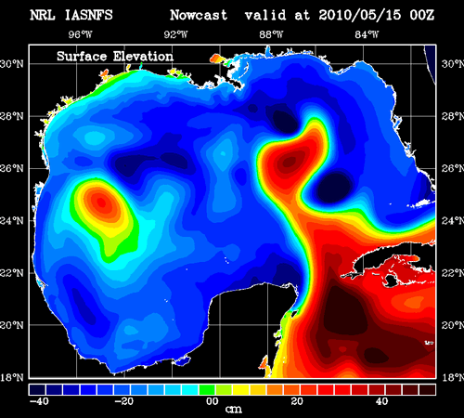
IASNFS Real-Time Prediction
Sea Surface Elevation

Slide 17
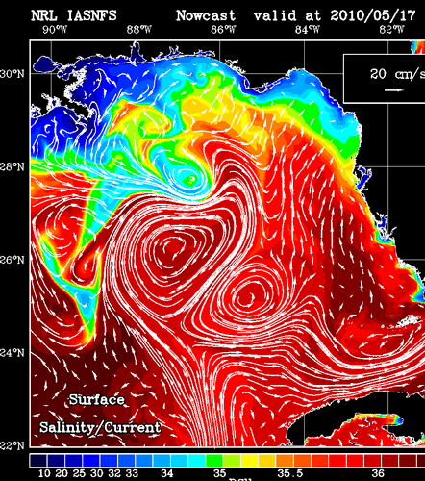
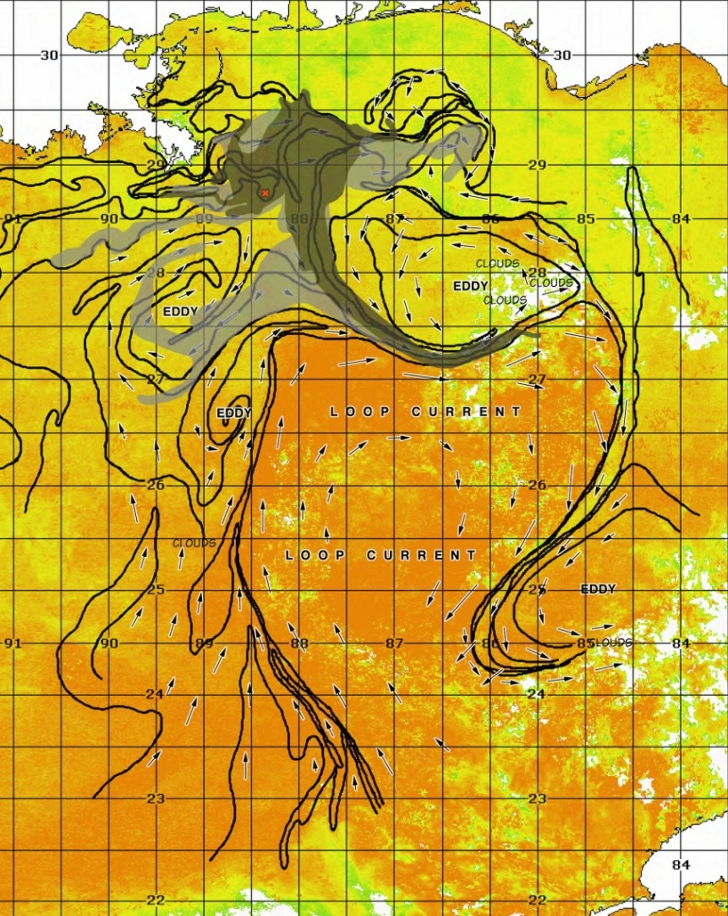
IASNFS Real-Time Prediction
Sea Surface Salinity/Current
Loop Current/Eddy frontal location
based on satellite thermo image

Slide 18
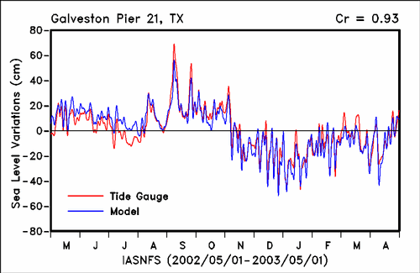
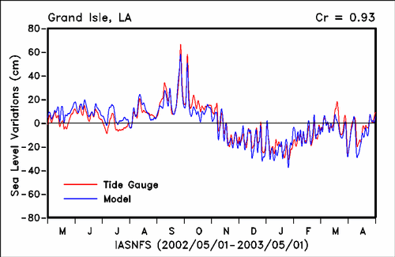
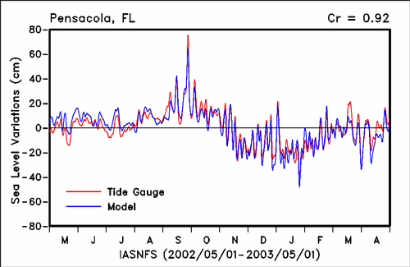
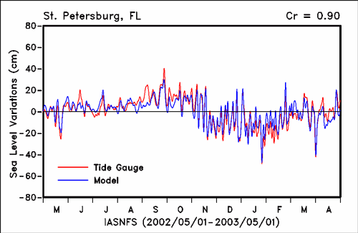
Coastal Sea Level Variation
vs. NOS Tide Gauge

Slide 19
LEO OEY, PRINCETON UNIVERSITY
POM

Slide 20
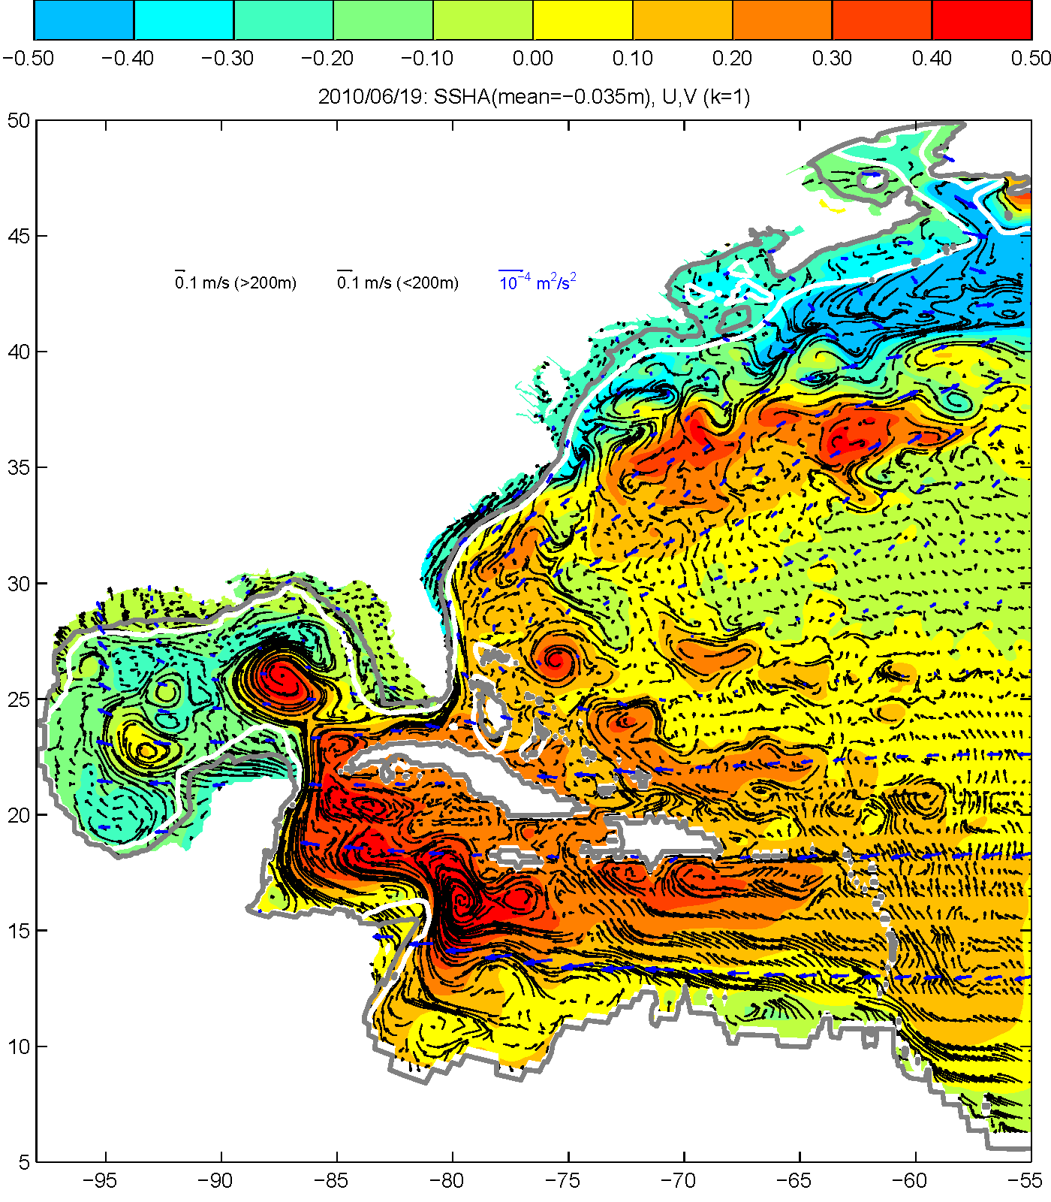
Princeton Regional Ocean Forecast System
U.S.A
Gulf of Mexico
Atlantic Ocean
Florida
Strait
Yucatan
Channel
Caribbean Sea

Slide 21
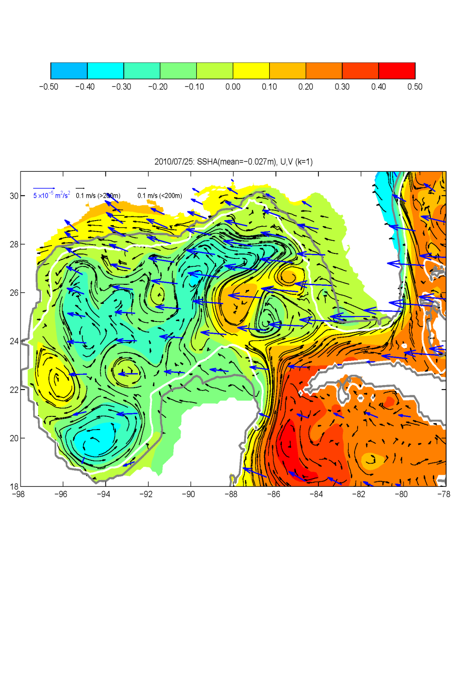

Slide 22
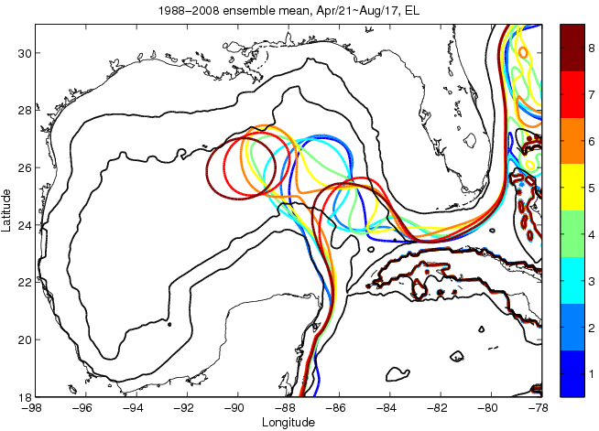

Slide 23
RUOYING HE, NCSU
&
YI CHAO, JPL & UCLA
ROMS, DATA ASSIMILATION, & ENSEMBLE MODELING

Slide 24
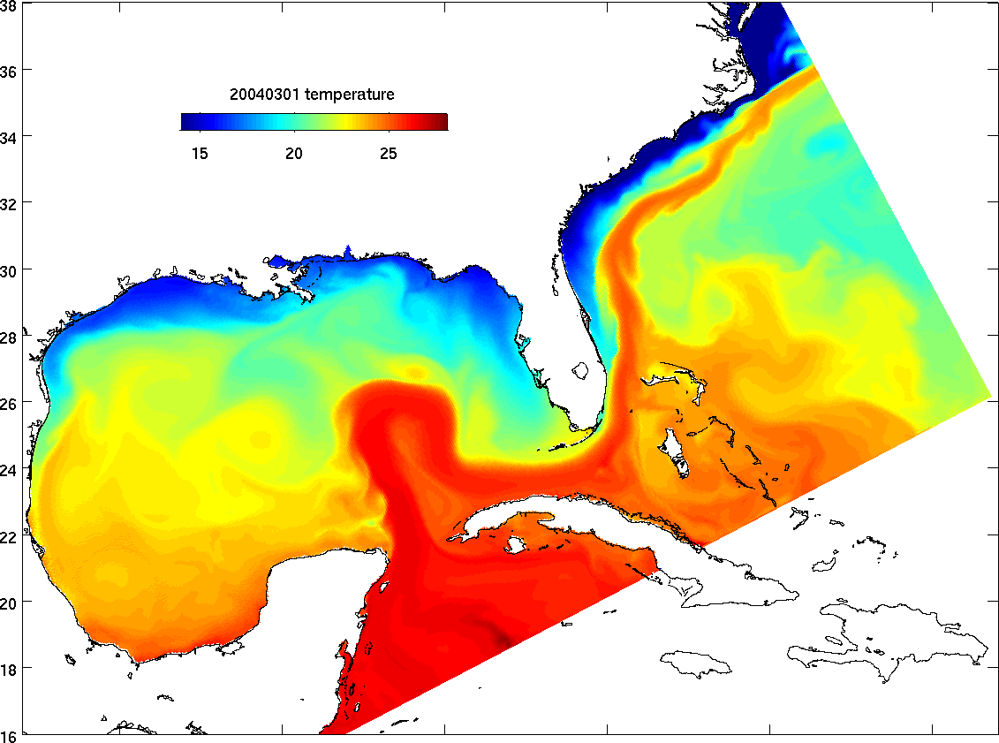
SABGOM ROMS
Hyun and He (2010)
5-km spatial resolution, 36 terrain- following
vertical layers
Nested inside global data (SST &SSH)
assimilative HYCOM model
NCEP NAM surface forcing
Major rivers and tides
Mellor-Yamada 2.5 turbulence closure

Slide 25
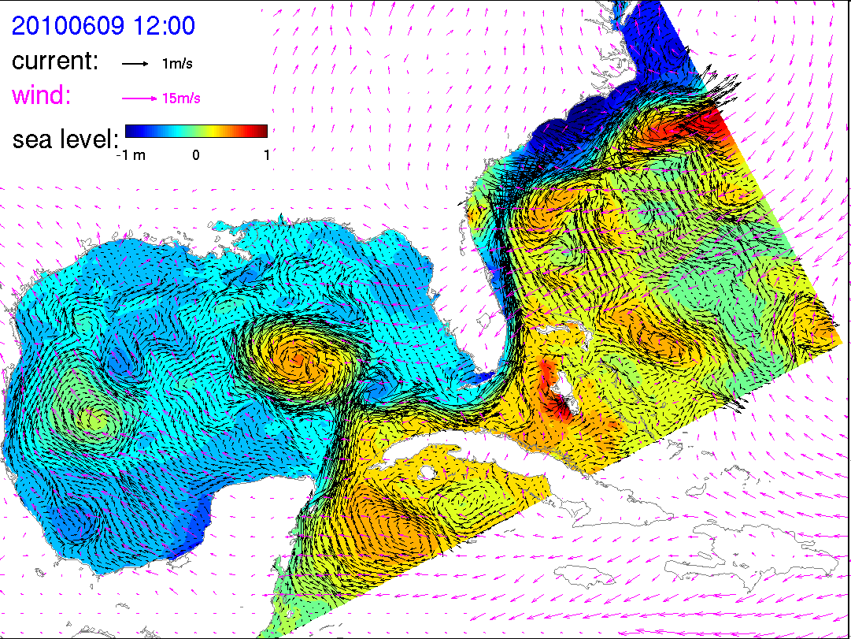
SABGOM circulation
nowcast/forecast snapshot
Eddy Franklin

Slide 26
SABGOM circulation nowcast/forecast has been used by NOAA OR&R in their official oil plume trajectory prediction

Slide 27
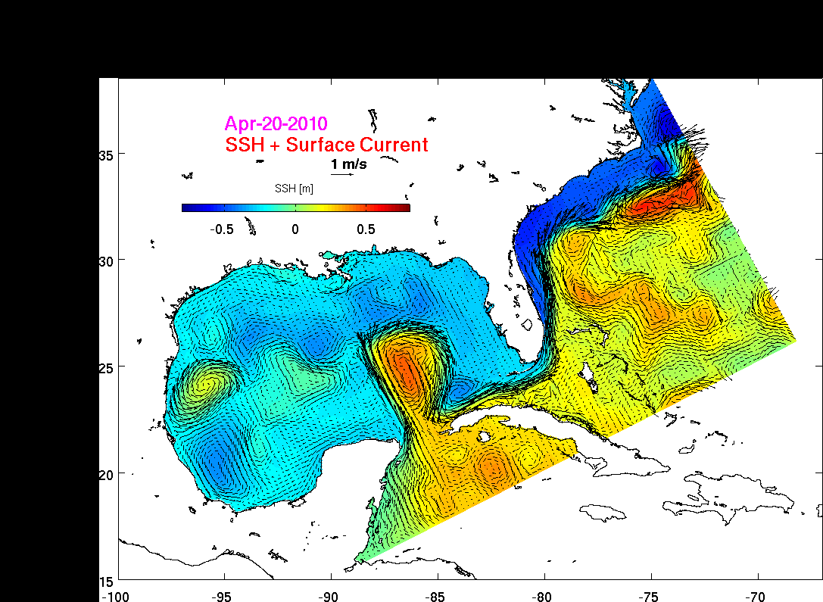
Nowcast/Forecast
SABGOM Hindcast Simulation (4/20 – 7/29)
Hourly 3-d circulation output

Slide 28
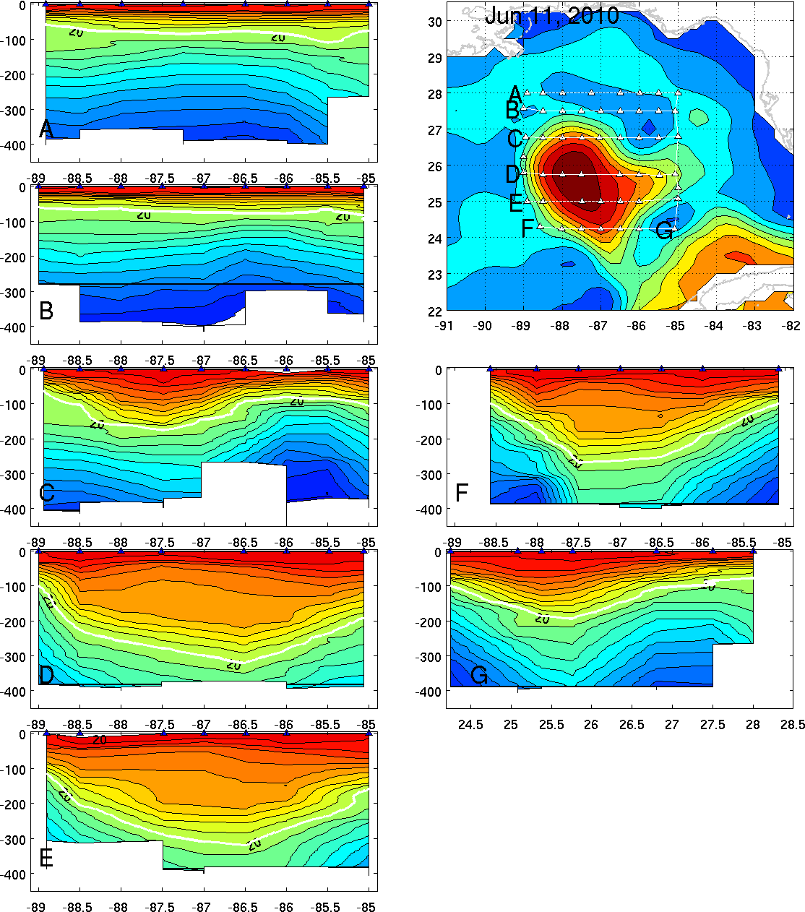
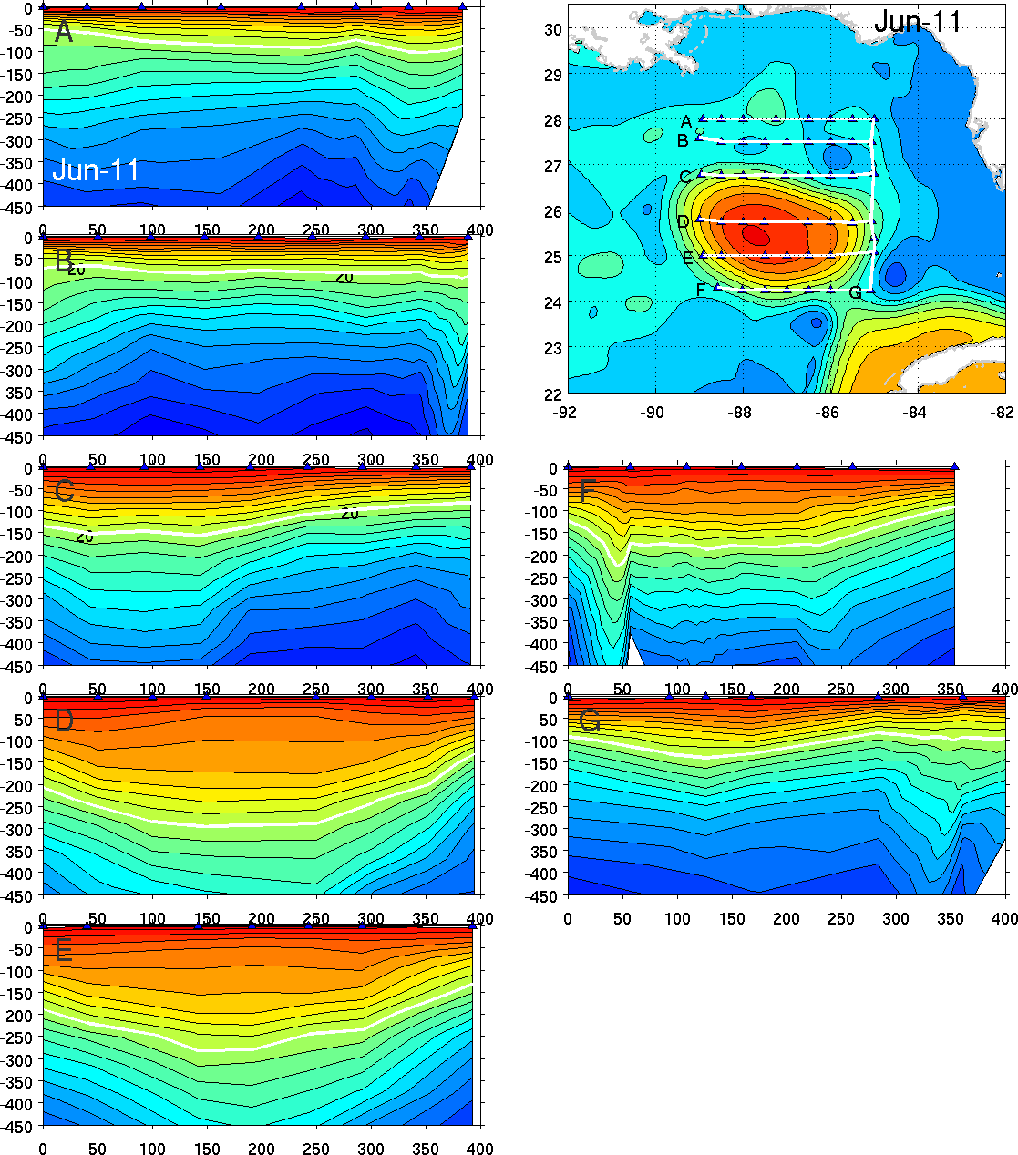
AXBT
SABGOM

Slide 29
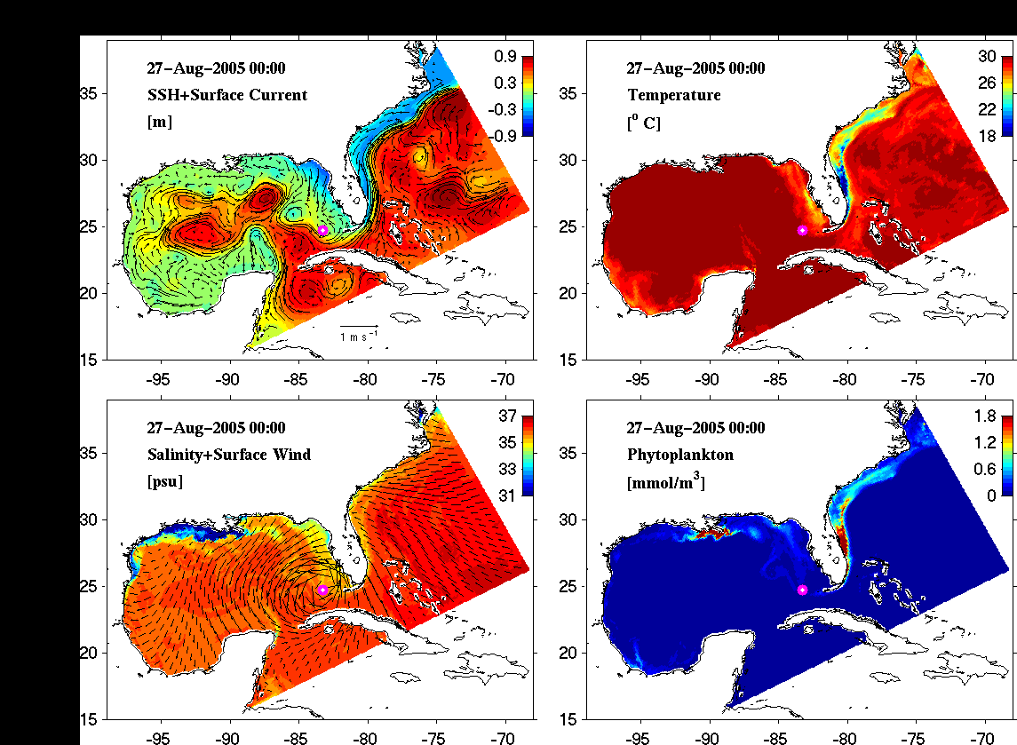
SABGOM ROMS Simulated Ocean Response to WRF Forcing Fields during Katrina

